Slide 1
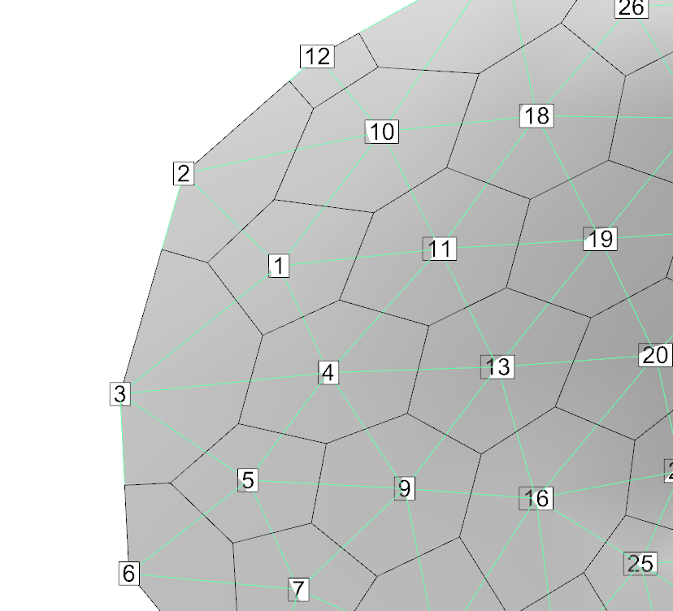
INTERNAL 1 (FREE) -1 ConnectionList JA()
1 2 3 4 10 11 1373
2 1 3 10 12 1374
INTERNAL 1 (FREE) -1 Connection Length CLN()
0.000000000000000 0.4816166314600873 0.5134932533106912 0.5264978726306505 0.7023922974188770
0.7240873882648168 4.9999999999999822E-02
0.000000000000000 0.7571564616062801 0.7387783820656399 1.067397991858902 1.311437904569524
4.9999999999999822E-02
INTERNAL 1 (FREE) -1 PerpendicularArea FAHL()
0.000000000000000 4.2840760529577818E-02 4.2686419682406392E-02 1.8872356266311795E-02 4.6389817028976807E-02 4.3930534595058086E-02 1.200443634791081
0.000000000000000 4.2840760529577818E-02 4.2840760529577818E-02 3.5824321454796124E-02 4.6389817028976807E-02 1.116920137042930

